Slide 1

DATA ANALYSIS AND STORYTELLING

Slide 2

METIS
Part of Kaplan, Inc.
Accredited by ACCET, a USDOE nationally recognized agency
Exclusively focused on data science training

Slide 3
INSTRUCTOR
Sophie Searcy
Senior Data Scientists at Metis
CTO at Elektra
BS & MS in Electrical and Computer Engineering

Slide 4
COURSE LOGISTICS
Time: 8:30 – 4:00
Lunch 12:00-1:00
Lectures, group discussions, and exercises

Slide 5
WORKFLOW

Slide 6
WORKFLOW
Plan
Collect Data
Explore Data
Model
Result

Slide 7
TODAY
Plan
Collect Data
Explore Data
Model
Result
Today

Slide 8
PLANNING
Identify the business problem to solve.
Translate the business problem to a data problem.
What do I need to solve this problem?
How will this solution be used?
The remaining workflow depends on what is decided here.
Plan
Collect Data
Explore Data
Model
Result
Notes:
What is the business problem? (How will this be used) How does this translate into a data problem? (What type of data problem) What data do I need?

Slide 9
DATA COLLECTION
What data do I need to solve my problem?
Where does it come from?
How much data do I need?
What type of data is it and in what format do I need it in?
Collect and transform data so that it’s in the desired format.
Plan
Collect Data
Explore Data
Model
Result
Notes:
Where is the data? What is the data type? Who to ask? Data quality?

Slide 10
DATA EXPLORATION
Process data so it’s usable with our tools
Identify any data quality issues.
Identify important elements in the data. Interesting relationships between data elements? Is the data what you expected?
Engineer new data elements.
Plan
Collect Data
Explore Data
Model
Result
Notes:
They’re not going to know what features are. Rephrase or explain. Possible to add an example table and highlight a row as observation, the feature columns, and target column to set the stage for vocab.
Maybe high level description at each of these during the workflow stage and then bullet details later

Slide 11
MODELING
What type of model do you need to build? Prediction? Grouping?
Build, test, and validate models.
Deploy model
Need to consider several issues including speed, interpretability, maintenance, etc.
Plan
Collect Data
Explore Data
Model
Result

Slide 12
RESULTS
Results need to be presented and communicated effectively.
Answers a specific question that drives a decision?
Reports generated for ongoing monitoring.
New products created.
End results should be kept in mind throughout the analysis.
Plan
Collect Data
Explore Data
Model
Result

Slide 13
ITERATIVE WORKFLOW
Plan
Collect Data
Explore Data
Model
Result

Slide 14
PLAN

Slide 15
PLAN
What problem am I trying to solve?
A key is to frame your problem as one that can be addressed in a principled way by a data science model.
Often helpful to re-frame a problem: “I have these tools. How do I frame the problem so that the tools can help me make progress?”
What should my data look like?
How many attributes do I need? Which ones? How many? What kind?
How much data do I need? How can it be acquired?
More on this later.

Slide 16
TYPES OF PROBLEMS
There are many types of data analysis problems.
Prediction
Prescription
Identification
Grouping
Abnormality
Relationships
Comparison

Slide 17
PREDICTION
Can I predict something?
What will widget sales be next February?

Slide 18
PRESCRIPTION
Can I prescribe something?
Which stocks should I invest in?

Slide 19
IDENTIFICATION
Can I identify this thing?
What type of plant is in this image?

Slide 20
GROUPING
How can I group things?
What are my different kinds of customers?

Slide 21
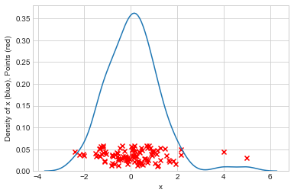
ABNORMALITY
Is this thing abnormal?
Is this purchase behavior indicative of fraud?
How unlikely is an event, given past history?
Which observations do not follow the pattern of the rest of the data?

Slide 22
RELATIONSHIPS
Is one thing related to another?
Does this %5 off coupon drive more sales of my product?
Is there correlation? When I go to the gym, I tend to sleep better.
If items are correlated then we can use one to predict the others.
Does one item cause another?
Causation requires correlation.
Correlation does not imply correlation.

Slide 23
COMPARISON
Can we compare sets of data?
I think this process will make my group more efficient. I try the process and compare my groups outcome against others.
How do transaction values compare to a threshold?
Does the outcome from one group differ from the outcome of another?

Slide 24
ACTIVITY
What question type is your group problem?
Brainstorm problems you would like to approach with data analysis
Which question types best addresses your problem?
Is there more than one way you could approach your problem?
Notes:
Get with your team and brainstorm the type of problem and approach for your business problem.

Slide 25
DATA COLLECTION

Slide 26
DATA COLLECTION
Our first step is to gather the data we’re interested in. This is often easier said than done!
Data comes from many places and each source presents its own challenges.
There are many types of data that require different ways to perform analysis.

Slide 27
DATA SOURCES
Data is sourced from many different places.
Human generated
IoT and machine generated
Public websites
Legacy documents
Multimedia
And many more…

Slide 28
DATA TYPES
There are multiple different types of data.
Numerical
Categorical
Ordinal
Time series
Image, audio, and text
And many more…

Slide 29
DATA TYPES
Numerical values take on numbers that describe quantities or magnitudes.
Numerical data can be continuous or discrete.
Continuous values can smoothly vary.
There are many possible values.
Ex: temperature, distance, what else?
Discrete data has a limited number of values
Ex: birth year, occupation, what else?

Slide 30
DATA TYPES
Categorical data describes membership in a category.
Can only be discrete
Ex: Genre, company name
Ordinal data is categorical data that has a specific order.
Not numeric
Ex: Level of education received

Slide 31
DATA ORGANIZATION
Tidy data is common-sense framework for storing data.
When data is tidy, thousands of Data Science tools work seamlessly. Some concepts just “make sense”.
Each row describes a single item, sometimes called an observations.
Each column describes a different “feature” of the observation.
“Happy families are all alike; every unhappy family is unhappy in its own way” (Tolstoy)

Slide 32
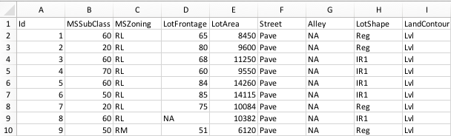
DATA ORGANIZATION
How many rows are there for a house that was sold twice?
Which features would have different values and which would be the same?
What do you think each row describes?

Slide 33
HOW MUCH DATA?
No hard and fast rule.
Generally depends on the question you’re asking and how strong you expect the answer to be.
More observations is always better, but data doesn’t always come easy. More features can hurt.

Slide 34
HOW MUCH DATA?
Small, subtle effects. At least 100-1,000 rows
In these cases, we don’t expect our answer to be extremely clear.
Comparing two groups that are expected to be mostly similar but possibly slightly different.
Comparing two variables that are generally unrelated but might be somewhat correlated.
Larger effects. At least 50 rows
In these cases we expect our answer to be quite clear: either there’s a big difference or there is not.

Slide 35
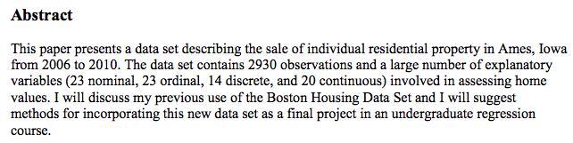
Ames Dataset
We’ll be using the Ames dataset today
A real dataset that is commonly used in Data Science Education.
You may read more about it here

Slide 36
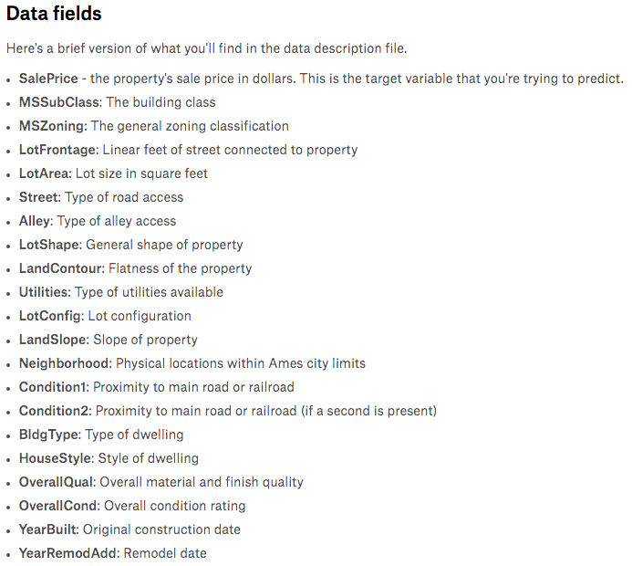
...

Slide 37
ACTIVITY
What data do you think would be useful for your project?
What type of data is it?
Where would you get it?
How much data do you think you will need?
Notes:
Get with your team and brainstorm the type of problem and approach for your business problem.

Slide 38
DATA EXPLORATION

Slide 39
DATA EXPLORATION
Data exploration is one of the most important steps in your workflow.
Many important questions can be answered at the exploration step
Basic outlier questions.
Catch problems early and save time.

Slide 40
TYPES OF ANALYSIS
There are many types of data analysis. We’ll cover four fundamental methods.
Detect Outliers: Which feature values are extreme and unexpected.
Baseline Comparison: Does the average of a feature tends to be above or below a baseline.
Compare groups: Do the averages of a feature differ between groups
Quantify relationships: Are two features related?
Detect Outliers
Baseline Comparison
Compare Groups
Quantify Relationships

Slide 41
BUILDING BLOCKS
We will build up to these methods after covering the following concepts:
Summarizing data
Mean, Median, Mode
Standard Deviation
Distributions: Normal Distribution

Slide 42
SUMMARIZATION
In exploration, we use tools to summarize and explain data.
On their own, columns of data tell us very little.
Imagine the numbers to the right were values for a feature:
What can you say about that feature just by looking at the numbers?
[19, 16, 17, 22, 22, 19, 18, 22, 26, 14]

Slide 43
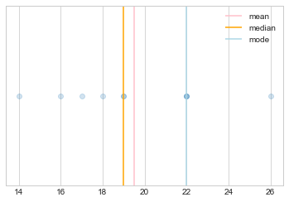
MEAN | MEDIAN | MODE
These measures summarize where values tend to land.
The mean is the average of the values in a feature.
The median is the middle value.
The median is greater than half the values and less than half.
The mode is the most frequent value.

Slide 44
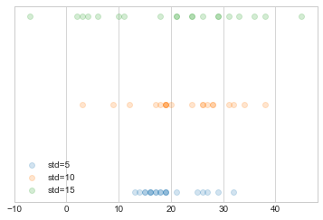
STANDARD DEVIATION
Standard deviation measures how spread out data is.
Unlike mean or median, standard deviation doesn’t tell you anything about the specific values you see, just how different each is likely to be.

Slide 45
DISTRIBUTIONS
Distributions generate data.
Ex: If you take everyone in this room’s name and put it in a jar, you now have a distribution for generating data—a list of our names. This distribution is different if you replace names after drawing them. It’s also different if you put your name in 10 times and everyone else’s once.

Slide 46
DISTRIBUTIONS
If we have data, we can guess what kind of distribution is likely to have generated that data.
Today we’ll cover one simple method for doing this. But it can be very complicated!

Slide 47
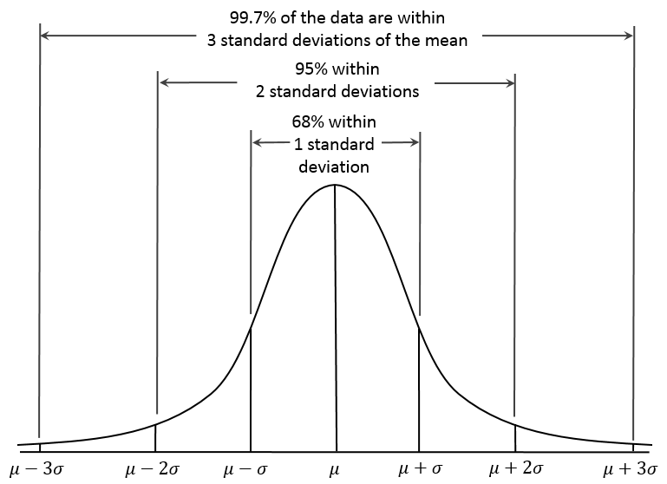
NORMAL DISTRIBUTION
Also called the Bell curve
Can be used to describe many values for a feature at a glance.
The bottom axis is the range of possible values
The height says how likely a value is.
For normally distributed data, values around the average are much more likely.

Slide 48
USING THE NORMAL DISTRIBUTION
The Normal distribution allows us to summarize an entire feature using two values: mean and standard deviation
How probable is each existing observation? How probable are hypothetical new ones.
Generate plausible dummy data.
Communicate nature of your feature “at a glance”.

Slide 49
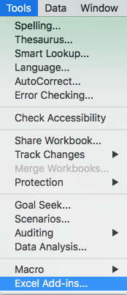
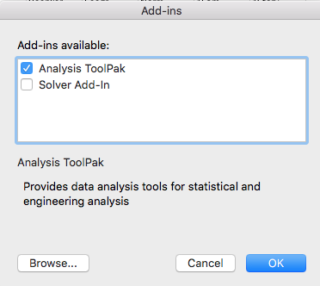
EXCEL ANALYSIS TOOLPACK
Select the Analysis Toolpak in the add-in menu

Slide 50
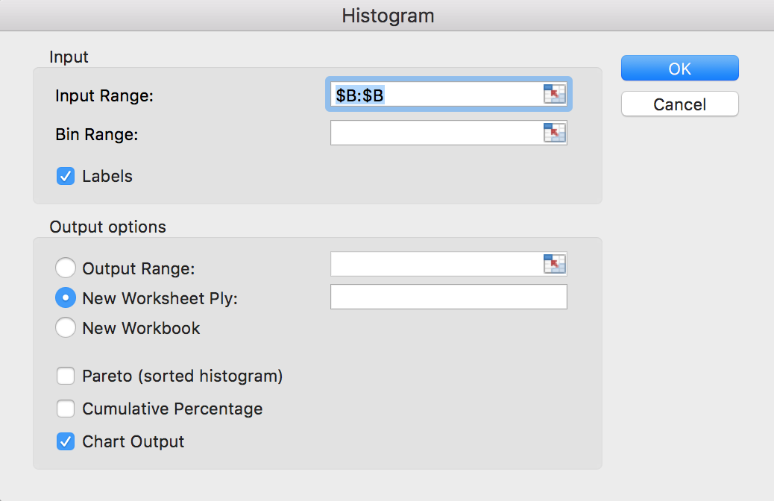
VIEWING A HISTROGRAM
Select Data Analysis -> Histogram

Slide 51
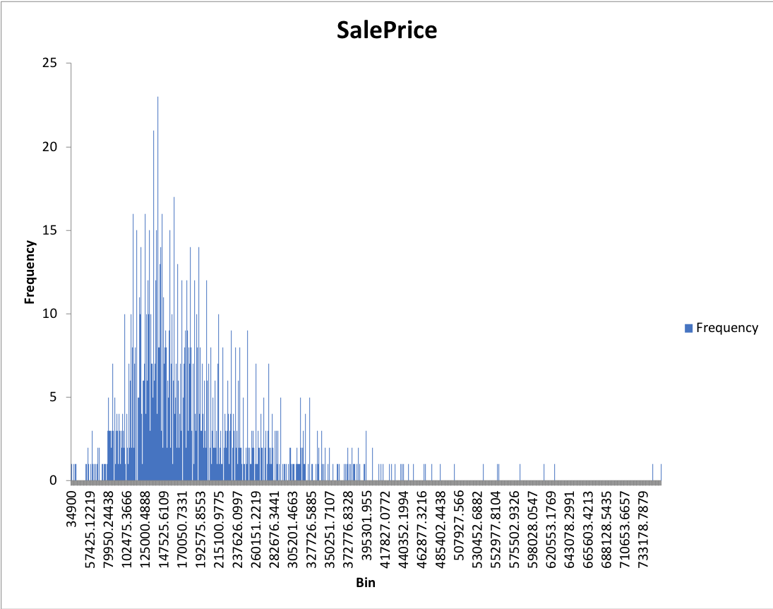
HISTOGRAM
A histogram gives a visual look at how often different values occur.
Counts how many values fall into each bin.

Slide 52
IS A FEATURE NORMAL?
There are statistical measures that can answer this question.
We will stick with visual checks. Yes -> Normal.
Is the histogram symmetric?
Is the mean close to the median?
Is the histogram unlimited in both directions?
Are there about as many outlier as we expect? (more info later)

Slide 53
IS A FEATURE NORMAL?
Normality is often a judgement call.
Tests can still be run on non-normal data, but conclusions should be interpreted with caution.

Slide 54
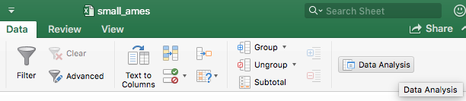
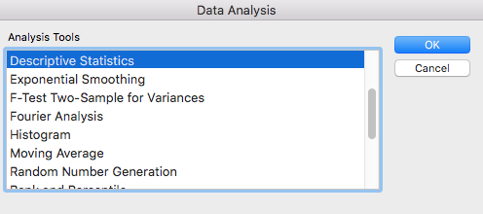
SUMMARIZE DATA
Access the Data Analysis tool
Select “Descriptive Statistics”

Slide 55
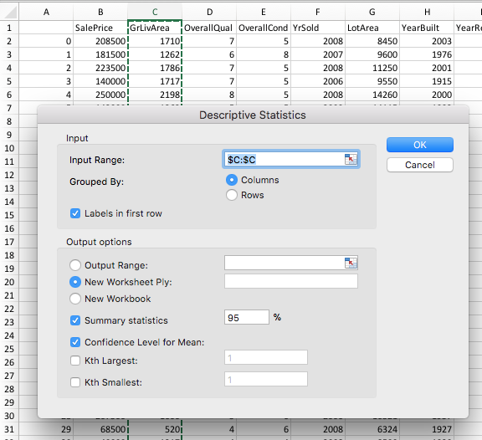
SUMMARIZE DATA
Select the entire Greater Living Area row with “C:C”
Be sure to check “labels in first row”

Slide 56
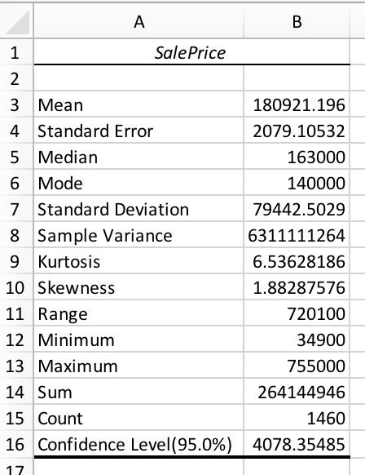
SUMMARIZE DATA
The mean and standard deviation tell us what our normal distribution looks like.
Also includes useful information like count, maximum and minimum.

Slide 57
DETECTING OUTLIERS
Why detect outliers?
Outliers have a very strong effect on many of our statistical measures. A single point very far away from other points can make or break a correlation.
Outliers can indicate a problem with the data or measurements. A 15lb baby is unlikely but a 25lb baby probably indicates a problem with the data.
Often informative on their own. In many cases, it’s simply useful to know which observations are surprising and which are expected.

Slide 58
DETECTING OUTLIERS
Outliers are something of a matter of taste. It’s rare that a value is impossible. So, instead we measure how unlikely a value is.
We use the normal distribution to put an estimate on this.

Slide 59
DETECTING OUTLIERS
We use the normal distribution to put an estimate on this.
Standardize the variable by replacing it with the number of standard deviations from the mean (1 standard deviation is σ).
Use the Normal Distribution to determine how many points should be falling that far from the mean.
Use judgement about where to draw the line to call something an outlier.
Standard deviation | Percent outside | Number outside
σ | 32% | 1/3
2σ | 4.5% | 1/22
3σ | .3% | 1/370
4σ | .006% | 1/16,000

Slide 60
DETECTING OUTLIERS
Example: You have 100 rows of client purchases. You suspect some of the purchases may be outliers. Where would you consider something an outlier?
If the data is normally distributed, out of 100 observations, we would expect
2σ: several points. Not surprising at all
3σ: one or a few. Somewhat surprising.
4σ: zero or nearly zero. Very surprising.
We could exclude points with a standard deviation greater than 3σ or if we want to be more conservative, we could set this at 4σ.

Slide 61
DETECTING OUTLIERS
In the Ames data, look at the SalePrice column
Find the descriptive statistics for SalePrice
Build a new column called SalePriceStandardized using the formula (x - mean)/std . Apply this to all following cells.
Use any method to select cells with values above your threshold. These are your outliers!

Slide 62
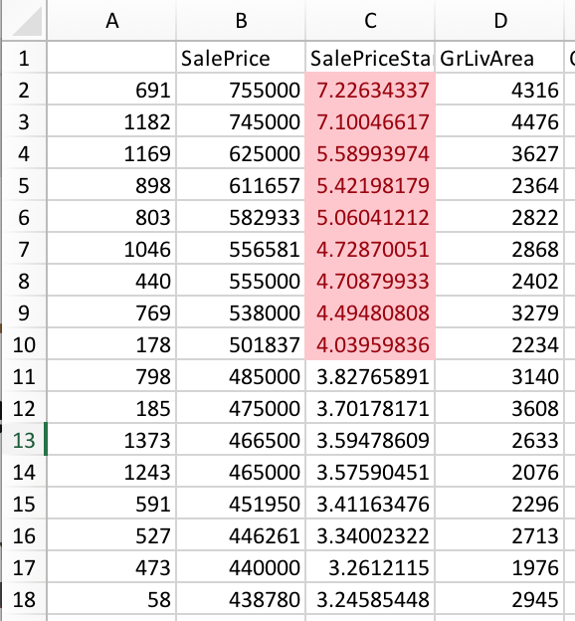
DETECTING OUTLIERS
Here are the 9 outliers if we set the threshold at 4σ.
What do you notice about them?
What to watch out for?
It’s easy to perform this analysis on data that is not Normal. But the conclusions won’t mean what you think they do, so be careful!

Slide 63
ACTIVITY
Sketch:
Pick a new column to do outlier analysis on.
Follow the steps in the previous slides to calculate the standard deviation of each value for that feature.
Select your cutoff for outliers and justify it.
Do you notice anything unusual about the outliers you found? Are there more or fewer than you expected? Does your data appear to be Normally Distributed?

Slide 64
COMPARING AGAINST A BASELINE
Why use comparison against a baseline?
Addresses a common scenario where we want to know how the values in a feature compare to some reasonable baseline.
Is X profitable?
Is X low enough?
Did we meet our goal?
Results are easy to interpret. Typically a simple up or down.

Slide 65
COMPARING AGAINST A BASELINE
We will build up to comparing against a baseline after covering the following concepts:
Hypotheses
Null vs Alternative
P values

Slide 66
HYPOTHESES
Think of a hypothesis as a “story” about your data.
Example: You set a target for the average value of transactions. One possible story is that the average is, in fact, above the target. Another is that the average transaction is similar to the target or less than. Who is right? Does looking at the mean answer?
We use hypotheses to design tests with clear outcomes.
Two hypotheses
One must be true and both can’t be true at the same time.
Alternative Hypothesis (H₁): The average is (different than/greater/lesser) than baseline.
Null Hypothesis (H₀): Everything else.

Slide 67
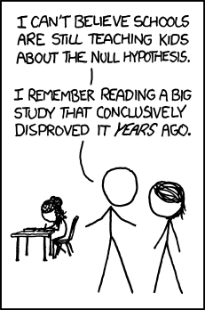
HYPOTHESES
We use hypotheses to design tests with clear outcomes.
Two hypotheses
One must be true and both can’t be true at the same time.
Alternative Hypothesis (H₁):
The average is (different than/greater/lesser) than baseline.
Null Hypothesis (H₀): Everything else.

Slide 68
P VALUES
Think of P values measuring surprise.
How surprised would you be to see something that happens:
1 out of every 10 times?
1 out of every 1,000 times?
1 out of every billion times?

Slide 69
P VALUES
Our tools provide a p-value as output. That p-values says “If we assume H₀ is true, this is how surprising your data would be”.
High p-value -> The data is not that surprising if we assume H₀, so we should stick with it.
Low p-value -> The data is surprising if we assume H₀. Consider accepting H₁.

Slide 70
COMPARING AGAINST A BASELINE
Steps
Form a hypothesis.
Form a null hypothesis that represents the default assumption.
Use a t-test to measure your p-value: how surprising the results would be if the null hypothesis were true.
Reject H₀ if your p-value is sufficiently low.
Notes:
T - test
How to do it and interpret the output

Slide 71
COMPARING AGAINST A BASELINE
Example
H₁: The average SalePrice is above $180,000.
H₀: The average SalePrice is below or similar to $180,000.
The t-test assigns p=0.09 , meaning we would expect results like this 9% of the time if H₀ is true.
The p value is too high so we keep H₀.
Notes:
T - test
How to do it and interpret the output

Slide 72
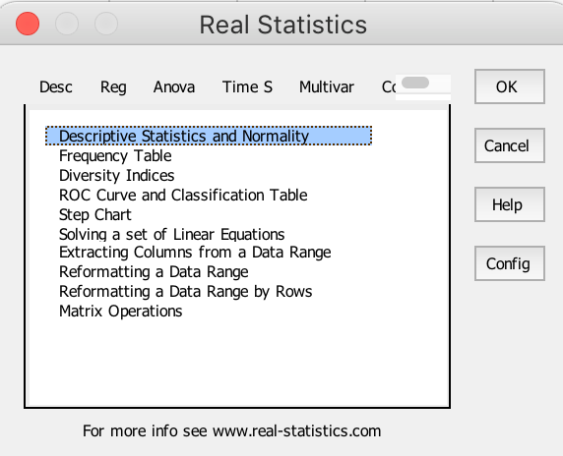
REAL STATISTICS RESOURCE PACK
Free tool that you can download here: http://www.real-statistics.com/real-statistics-resource-pack/
Activate with ctrl-m

Slide 73
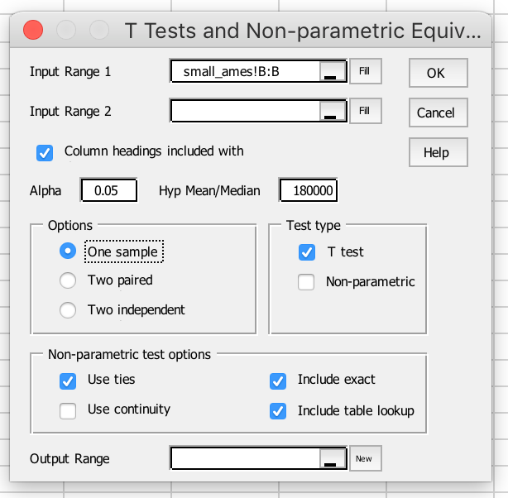
COMPARING AGAINST A BASELINE
Activate Real Statistics with command-m or control-m.
Misc -> T Test and Non-parametric Equivalents
For comparing to a baseline, select One Sample and enter a Hypothesis Mean.
Notes:
T - test
How to do it and interpret the output

Slide 74
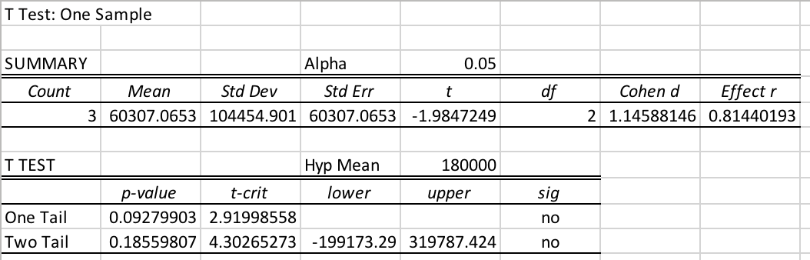
COMPARING AGAINST A BASELINE
Summary stats
One tail: when we care about greater than only or lesser than only.
Two tail: when we care about whether the mean is different in either direction.
Notes:
T - test
How to do it and interpret the output

Slide 75
COMPARING AGAINST A BASELINE: GOTCHAS
Before running tests, plan your p-value cutoff, two-tailed vs one-tailed, and other details.
If not, it’s tempting to move the goalposts after results are seen.
Set p-value cutoff according to your circumstances.
P <= 0.05 : Willing to accept hypothesis on relatively weak evidence
P <= 0.01 : Willing to accept hypothesis on strong evidence
P <= 0.001 : Willing to accept hypothesis on very strong evidence
Watch out for multiple comparisons!
P = 0.05 means that we would expect to see this pattern 5% of the time, even when our theory is wrong! What if we ran 20+ tests?
Notes:
T - test
How to do it and interpret the output

Slide 76
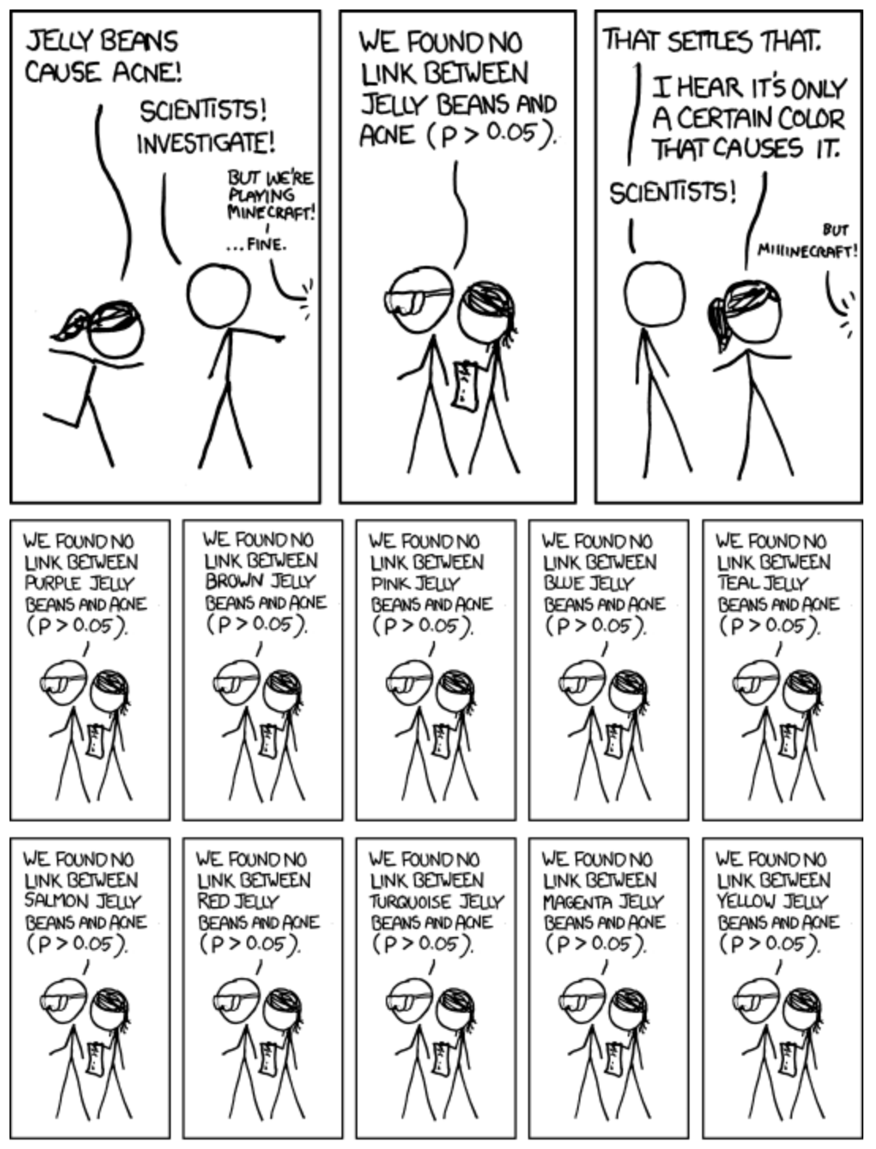
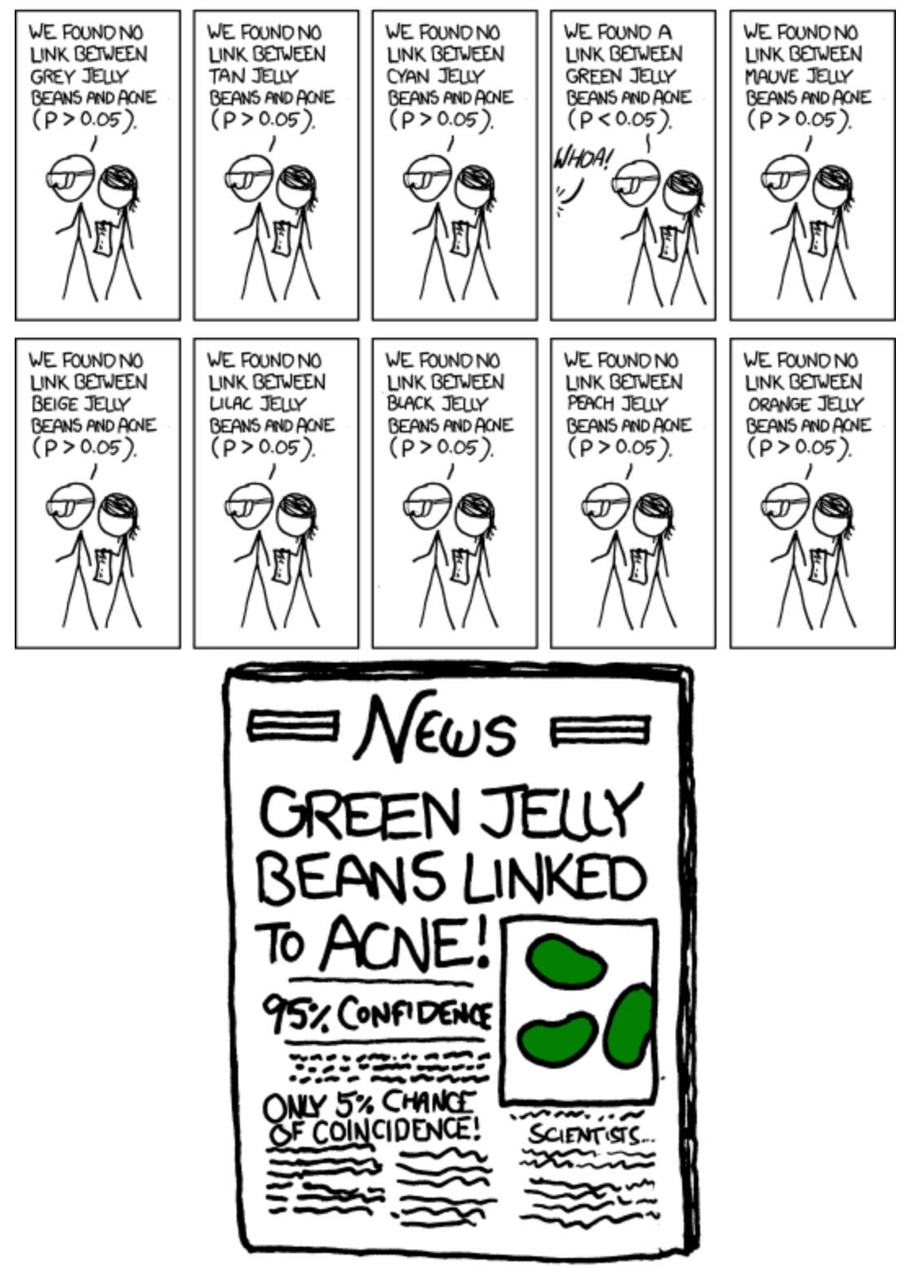

Slide 77
COMPARING GROUPS
Why compare groups?
Any time you want to compare between two similar groupings of data (more than two will have to wait for another time).
Test an intervention (often called A/B testing): If we try a new method for X, does the average outcome change?
Provides clear, interpretable test and results.
Can be used as an exploratory step to decide if groups can be combined.
Detect Outliers
Compare against baseline
Compare groups
Quantify Relationships
Notes:
T - test
How to do it and interpret the output

Slide 78
COMPARING GROUPS
Important difference from baseline comparison is that we’re comparing two columns.
Suggestion:
Use tidy data format (from earlier).
Use 2 features
Feature you want to compare
Feature you want to use to divide groups
Use filters and copy/paste to form groups (example in a moment).

Slide 79
COMPARING GROUPS EXAMPLE
Do houses sold before 2009 and houses sold in 2009 or later have different sale prices?

Slide 80
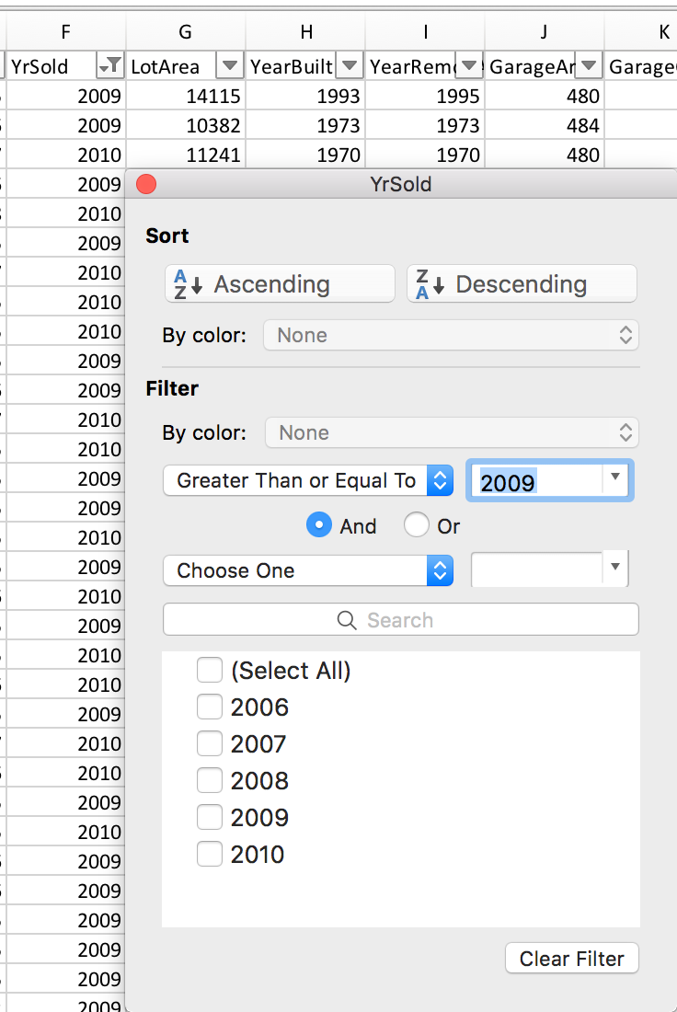
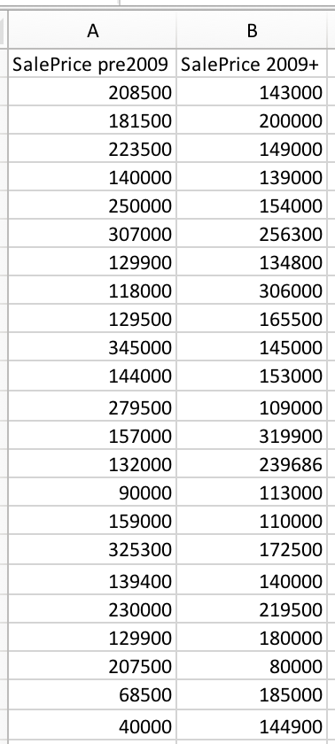
COMPARING GROUPS EXAMPLE
Create new columns by filtering then copying the filtered contents as a new column.

Slide 81
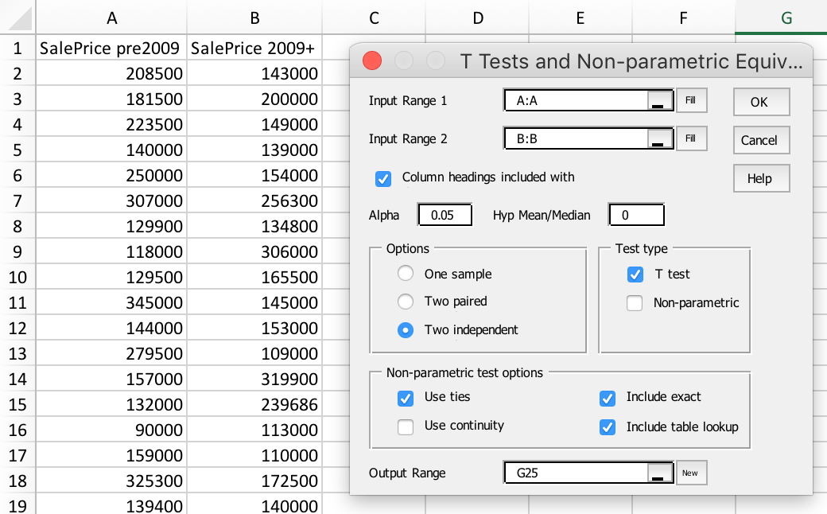
COMPARING GROUPS
Compare the values in the two groups
command/control-m to open Real Stats
Misc -> T Test…
Be sure to use the new columns you just created.

Slide 82
INTERPRETATION
Variances
Equal: we know both groups should have equal standard deviation.
Unequal: otherwise
As before, one-tailed is used when we only care about one direction (group 1 is greater than group 2).
Two-tailed is when we care about differences in either direction.

Slide 83
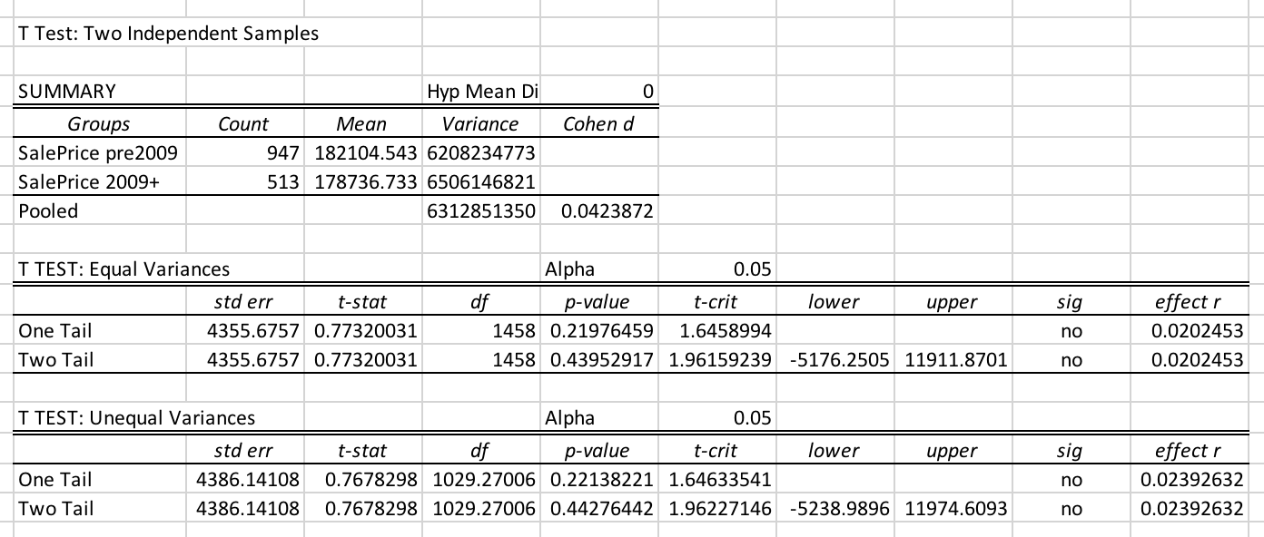
INTERPRETATION

Slide 84
QUANTIFYING RELATIONSHIPS
Why quantify relationships?
Correlation is a building block for later analyses.
If two variables are correlated, one can be predicted from the other
All else equal
Correlation is necessary for causation.
If X and Y are not correlated, then X doesn’t cause Y and Y does not cause X.
If X and Y are correlated, we still can’t infer causation (more on that another day).
Notes:
T - test
How to do it and interpret the output

Slide 85
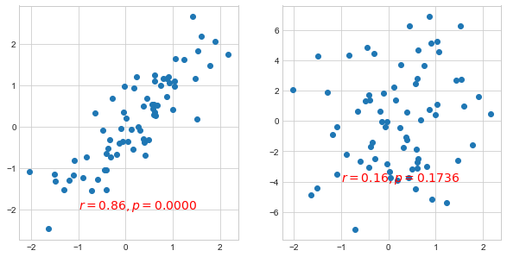
R
R measures how related two features are.
A perfect correlation is R=1 (the max).
R can be negative and there’s no limit how much.
Comes with a p-value just like previous tests.
Low enough p-value: reject null hypothesis that features are unrelated.

Slide 86
R

Slide 87
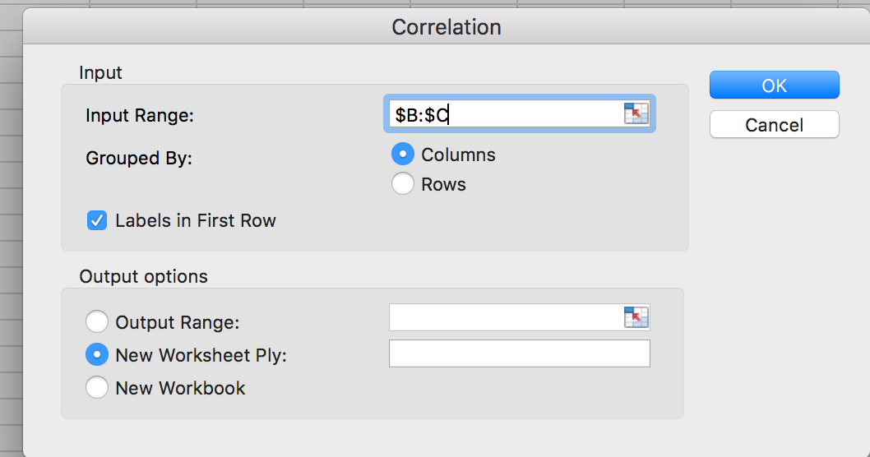
CORRELATION
Include relevant columns in the “Input Range”
Try for two features. Now, what happens when you have more than 2 columns?

Slide 88
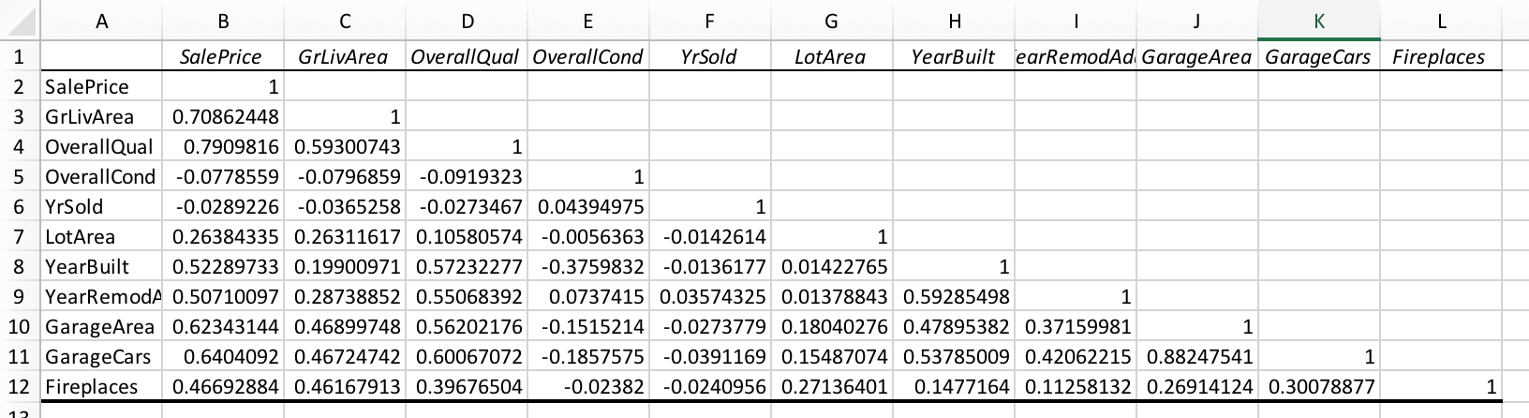
CORRELATION
The result is a matrix that looks like this, giving the correlation between each pair of features.
Which features best predict SalePrice? Is this what you would expect?

Slide 89
ACTIVITY
Sketch: Organize into groups. Plan out your analysis for the data and problem you have previously chosen.
List the steps you plan to perform. Which Exploration tools will you use? Do you have the right data in the right format?
Note: It’s okay if it turns that you come to the conclusion that you need to use a different tool than you expected.

Slide 90

THANK YOU!

